Slide 1
MCTS Guide to Microsoft Windows 7
Chapter 7
Windows 7 Security Features

Slide 2
Objectives
Describe Windows 7 Security Improvements
Use the local security policy to secure Windows 7
Enable auditing to record security events
Describe and configure User Account Control
Describe the malware security features in Windows 7
Use the data security features in Windows 7
Secure Windows 7 by using Windows Update

Slide 3
Windows 7 Security Improvements
Major security improvements in Windows 7 are:
Malware protection
Easier deployment of alternative authentication methods
Enhanced network protection
Data protection for stolen hard drives
AppLocker for software restriction

Slide 4
Malware Protection
Malware
Malicious software designed to perform unauthorized acts on your computer
User Account Control (UAC)
Feature implemented in Windows 7 to control malware
Prompts users when software attempts to take administrative control
Windows Defender
A real-time spyware monitor to prevent the installation of and remove spyware

Slide 5
Malware Protection (cont'd.)
Spyware
A threat to privacy; makes systems unstable
Internet Explorer has been modified to run in a limited state (protected mode)
User files cannot be modified
A phishing filter has also been added
Prevents unauthorized Web sites from stealing log-on credentials and other personal information

Slide 6
Malware Protection (cont'd.)
Windows service hardening
Most Windows exploits used to install malware are the result of flaws in Windows services
Windows services have been changed as follows:
Each service is given a SID number
Services run with a lower privilege level by default
Unnecessary privileges for services have been removed
Windows Firewall can control network access based on service SIDs
Services are isolated and cannot interact with users

Slide 7
Alternative Authentication Methods
Username and password
Most common method for authentication
Windows 7 makes smart cards easier to manage
Development of additional authentication methods for Windows, such as biometrics, has been simplified

Slide 8
Network Protection
Windows 7 is protected on networks by:
Enhanced firewall
Network Access Protection (NAP)
Firewall can control both inbound and outbound network packets
NAP prevents unhealthy computers from accessing the network
An unhealthy computer is one that has outdated antivirus signatures or is missing security updates

Slide 9
Data Protection
NTFS file system provides data protection by using permissions on files and folders
NTFS permissions can be easily circumvented when you have physical access to a computer
BitLocker Drive Encryption
Encrypts the contents of a partition and protects the system partition

Slide 10
AppLocker for Software Restrictions
AppLocker simplifies the management of software restrictions
By implementing simpler rules than were available in software restriction policies

Slide 11
Security Policies
Windows 7 includes a local security policy
Can be used to control many facets of Windows
Can be accessed in the Local Security Policy in Administrative Tools
Local security policy categories
Account policies
Local policies
Windows Firewall with Advanced Security
Network List Manager Policies
Public Key Policies

Slide 12
Security Policies (cont'd.)
Local security policy categories (cont'd.)
Software Restriction Policies
Application Control Policies
IP Security Policies on Local Computer
Advanced Audit Policy Configuration
The local security policy is part of a larger Windows management system called Group Policy
Can be implemented on a local computer, but is typically part of a domain-based network

Slide 13
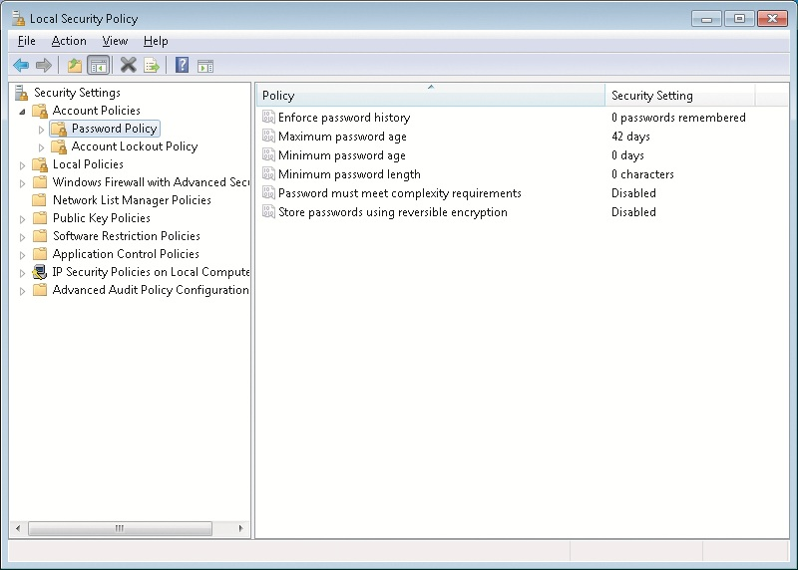
Security Policies Window

Slide 14
Account Policies
Contain the password policy and the account lockout policy
Do not affect domain accounts
Must be configured at the domain level
Password policy
Controls password characteristics for local user accounts
Available settings
Enforce password history
Maximum password age
Minimum password age
Minimum password length
Password must meet complexity requirements
Store passwords using reversible encryption

Slide 15
Account Policies (cont'd.)
Account lockout policy
Prevents unauthorized access to Windows 7
Can configure an account to be temporarily disabled after a number of incorrect log-on attempts
Available settings
Account lockout duration
Account lockout threshold
Reset account lockout counter after

Slide 16
Local Policies
Local policies are for:
Auditing system access
Assigning user rights
Configuring specific security options
Auditing lets you track when users log on and which resources are used
User rights control what system task a particular user or group of users can perform
Specific security options are a variety of settings that can be used to make Windows 7 more secure

Slide 17
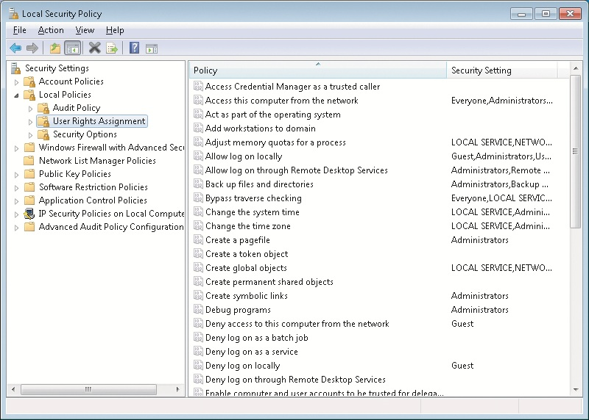
Local Security Policies Window

Slide 18
Local Policies (cont'd.)
User rights assignment settings
Allow log on locally
Back up files and directories
Change the system time
Load and unload device drivers
Shut down the system
Security options settings
Devices
Interactive logon
Shutdown

Slide 19
AppLocker
Used to define which programs are allowed or disallowed in the system
Used in corporate environments where parental controls are not able to be used
Enhancements over software restriction policies:
Rules can be applied to specific users and groups rather than all users
Default rule action is deny to increase security
Wizard to help create rules.
Audit only mode for testing that only writes events to the event log

Slide 20
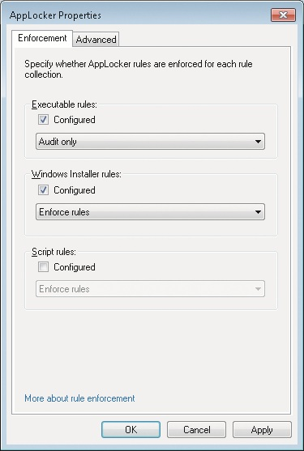
AppLocker Properties Window

Slide 21
AppLocker (cont'd.)
You can audit or enforce AppLocker rules
Relies on the configuration of appropriate rules and the Application Identity service
Rule Collections
Executable
Windows Installer
Scripts
DLL

Slide 22
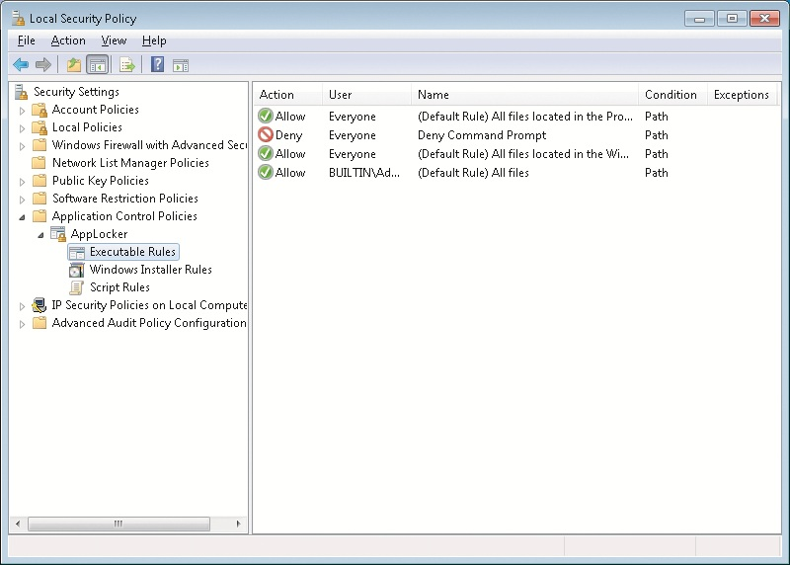
AppLocker Executable Rules

Slide 23
AppLocker (cont'd.)
Rule Permissions
Each rule contains permissions that define whether the rule allows or denies software the ability to run
Rule Conditions
Define the software that is affected by the rule
Three conditions that can be used:
Publisher
Path
File hash

Slide 24
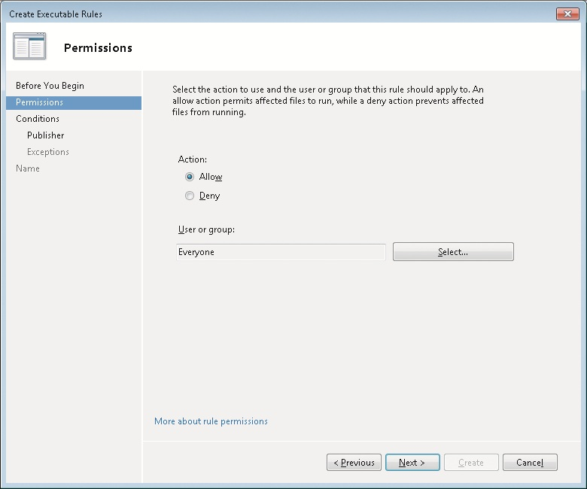
AppLocker Permission Window

Slide 25
AppLocker (cont'd.)
Rule Exceptions
Define software that the rule does not apply to

Slide 26
Other Security Policies
Windows Firewall with Advanced Security
Used to configure the new firewall in Windows 7
Lets you configure both inbound and outbound rules
Can be used to configure IP Security (IPsec) rules
Network List Manager Policies control how Windows 7 categorizes networks
Public Key Policies has a single setting for the Encrypting File System (EFS)
IP Security Policies on Local Computer are used to control encrypted network communication

Slide 27
Security Templates
Security templates are .inf files that contain:
Settings that correspond with the Account Policies and Local Policies in the local security policy
Settings for the event log, restricted groups, service configuration, registry security, and file system security
Edited by using the Security Templates snap-in
Security templates are used by Security Configuration and Analysis tool and Secedit

Slide 28
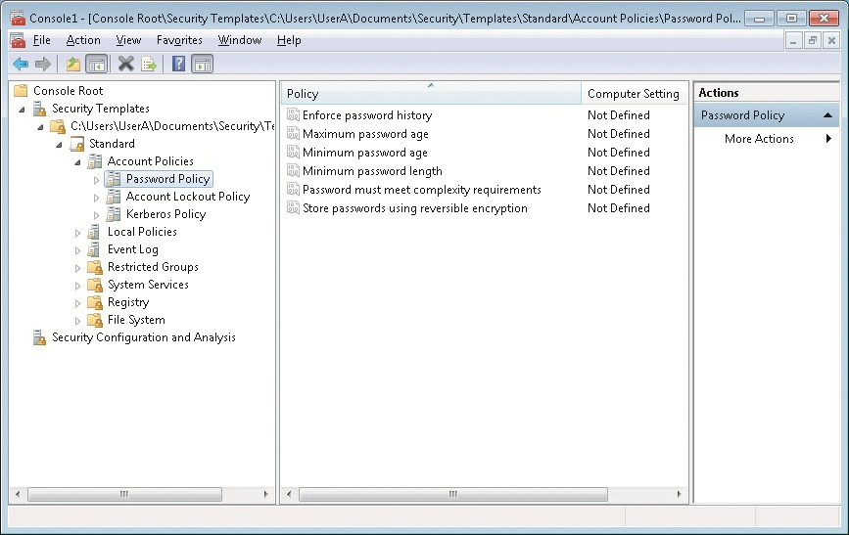
Security Templates Window

Slide 29
Security Templates (cont'd.)
Tasks you can perform with the Security Configuration and Analysis tool
Analyze
Configure
Export

Slide 30
Auditing
Auditing
Security process that records the occurrence of specific operating system events in the Security log
Every object in Windows 7 has audit events related to it
Auditing is enabled through the local security policy or by using Group Policy
Once the audit policy is configured
The audited events are recorded in the Security log that is viewed by using Event Viewer

Slide 31
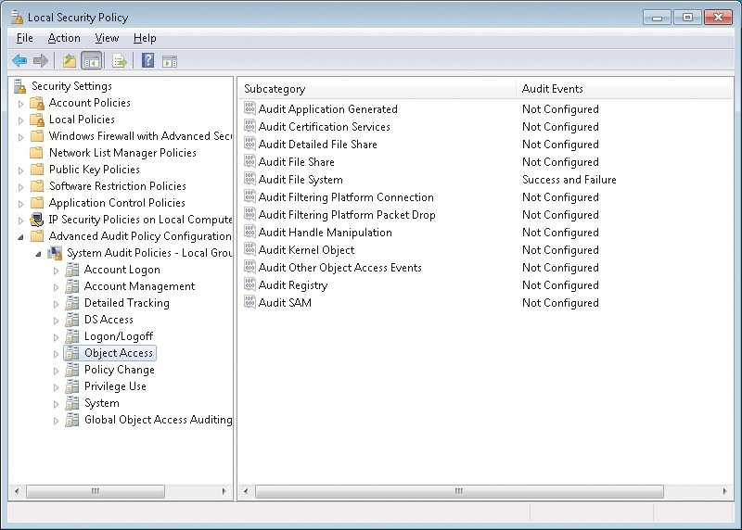
Auditing

Slide 32
Auditing (cont'd.)
To review the event categories for advanced audit policy settings see page 302 in book.

Slide 33
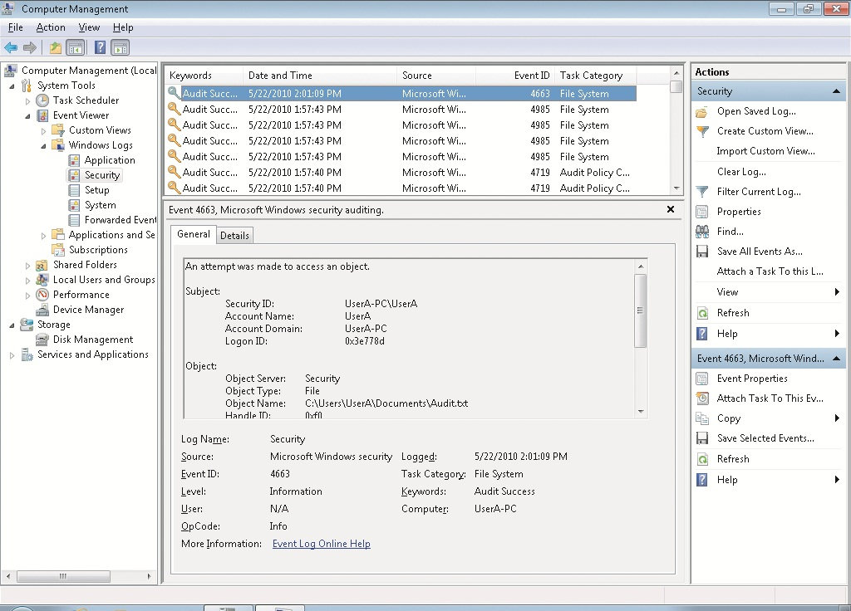
Auditing Single Event Information

Slide 34
User Account Control
User Account Control (UAC)
Feature introduced in Windows Vista that makes running applications more secure
Security is enhanced by reducing the need to log on and run applications using administrator privileges
When UAC is enabled and an administrative user logs on
Administrative user is assigned two access tokens
Standard user privileges
Administrative privileges

Slide 35
User Account Control (cont'd.)
Standard user access token is used to launch the Windows 7 user interface
Admin Approval Mode
Ensures that the access token with administrative privileges is used only when required
Application Information Service
Responsible for launching programs by using the access token with administrative privileges

Slide 36
Application Manifest
Application manifest
Describes the structure of an application
Includes required DLL files and whether they are shared
Applications that are not designed for Windows 7 and which require administrative privileges
Do not properly request elevated privileges
Fix it by using the Application Compatibility Toolkit

Slide 37
UAC Configuration
Windows 7 introduces a simplified interface for managing UAC
UAC is configured by using either:
Windows 7 Local Security Policy
For small environments
Group Policy
For larger environments

Slide 38
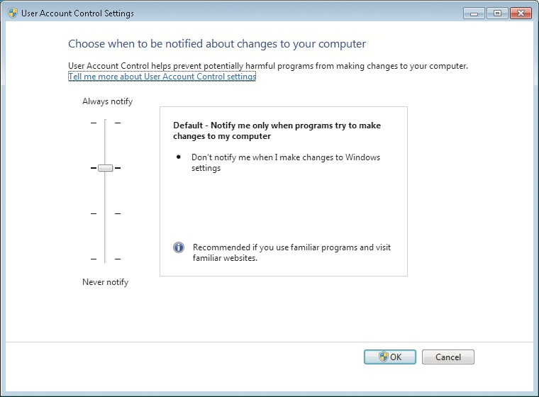
UAC Account Control Settings

Slide 39
UAC Configuration (cont’d.)
To review UAC configuration options see page 307 in book.

Slide 40
Malware Protection
Windows 7 includes the following features to protect computers from malware:
Windows Defender
Microsoft Security Essentials

Slide 41
Windows Defender
Antispyware software included with Windows 7
Spyware
Software that is silently installed on your computer, monitors your behavior, and performs actions based on your behavior
Windows Defender provides two levels of protection:
On-demand scanning
Real-time scanning
Scanning use signatures to identify spyware

Slide 42
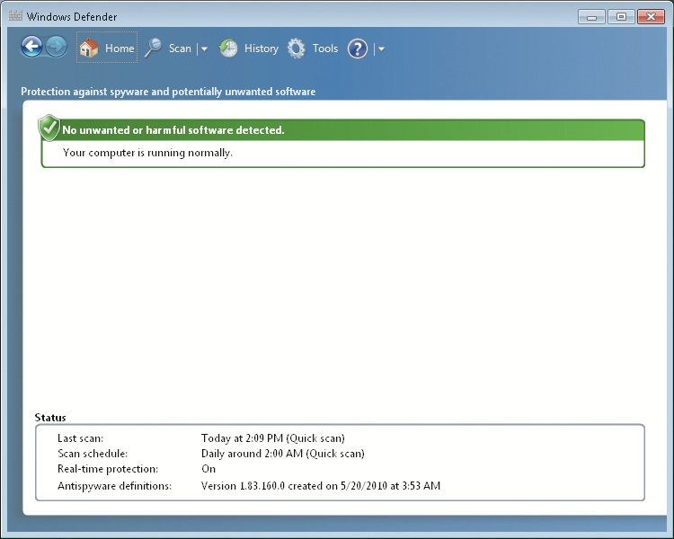
Windows Defender Window

Slide 43
Windows Defender (cont'd.)
On-Demand Scanning
Windows Defender can perform ad hoc scanning
When you suspect that spyware is present on your computer
Windows Defender can also perform scheduled scans
Real-Time Scanning
Constantly monitors your computer and alerts you when spyware attempts to install
Better than on-demand scanning because you are preventing the problem rather than fixing it
Protects the following areas:
Downloaded files and attachments
Programs that run on my computer

Slide 44
Windows Defender (cont'd.)
Windows Defender Alert Levels
Severe or High
Medium
Low
Windows Defender Actions
When malware is detected, it can be quarantined, removed, or allowed
You can define default actions that are applied for severe, high, medium, and low alerts

Slide 45
Data Security
NTFS permissions
Most basic level of data security in Windows 7
Stop logged-on users from accessing files and folders that they are not assigned read or write permission to
Relatively easy to work around NTFS permissions
When you have physical access to the computer
To secure data on desktop computers and laptops, encryption is required
Windows 7 includes Encrypting File System (EFS) and BitLocker Drive Encryption

Slide 46
Encryption Algorithms
Encryption makes data unreadable
Decryption makes data readable again
Symmetric encryption
Same key to encrypt data and decrypt data
The key is a long number that is very hard to guess
Symmetric encryption is strong and fast
Good for encrypting large volumes of data such as files
Used by both EFS and BitLocker Drive Encryption
Biggest problem is securing the key

Slide 47
Encryption Algorithms (cont'd.)
Asymmetric encryption
Uses two keys to encrypt and decrypt data
Data encrypted by one key is decrypted by the other
Keys are part of a digital certificate
Digital certificates are obtained from certificate authorities
Requires more processing power and is less secure than symmetric encryption
Use symmetric encryption to encrypt the data and then use asymmetric encryption to protect just the symmetric key

Slide 48
Encryption Algorithms (cont'd.)
Hash encryption
One-way encryption
It encrypts data, but the data cannot be decrypted
Used to uniquely identify data rather than prevent access to data
Sometimes hash values for data are called fingerprints
Used for storing passwords
When passwords are stored as only a hash value, it is impossible to decrypt the password

Slide 49
Encrypting File System
Encrypting File System (EFS)
First included with Windows 2000 Professional
Encrypts individual files and folders on a partition
Suitable for protecting data files and folders on workstations and laptops
Can also be used to encrypt files and folders on network servers
File or folder must be located on an NTFS-formatted partition

Slide 50
Encrypting File System (cont'd.)
To use EFS, users must have a digital certificate with a public key and a private key
Windows 7 can generate one for you
From the user perspective, encryption is a file attribute
Files can also be encrypted using the command-line utility Cipher
Lost encryption keys
If a user loses the EFS key, then an encrypted file is unrecoverable with the default configuration

Slide 51
Encrypting File System (cont'd.)
Lost encryption keys
Some ways EFS keys may be lost
The user profile is corrupted
The user profile is deleted accidentally
The user is deleted from the system
The user password is reset
In User Accounts, there is an option to manage file encryption certificates
Allows you to view, create, and back up certificates
Creating a recovery certificate allows the files encrypted by all users to be recovered if required

Slide 52
Encrypting File System (cont'd.)
Lost encryption keys (cont'd.)
Steps for creating and using a recovery certificate
Create the recovery certificate
Install the recovery certificate
Update existing encrypted files
Sharing Encrypted Files
Steps to work with encrypted files on multiple computers
Encrypt the file on the first computer
Export the EFS certificate, including the private key from the first computer

Slide 53
Encrypting File System (cont'd.)
Sharing Encrypted Files (cont'd.)
Steps to work with encrypted files on multiple computers (cont'd.)
Import the EFS certificate, including the private key on the second computer
Open the encrypted file on the second computer
Steps to share encrypted files with other users
Export the EFS certificate of the first user, but do not include the private key
Import the EFS certificate of the first user into the profile of the second user as a trusted person
Second user encrypts file and shares it with first user

Slide 54
Encrypting File System (cont'd.)
Moving and Copying Encrypted Files
Encrypted files behave differently when copied or moved
Rules for moving and copying encrypted files
An unencrypted file copied or moved to an encrypted folder becomes encrypted
An encrypted file copied or moved to an unencrypted folder remains encrypted
An encrypted file copied or moved to a FAT partition, FAT32 partition, or floppy disk becomes unencrypted
If you have access to decrypt the file

Slide 55
Encrypting File System (cont'd.)
Moving and Copying Encrypted Files (cont'd.)
Rules for moving and copying encrypted files (cont'd.)
If you do not have access to decrypt a file, then you get an access-denied error
If you attempt to copy or move the file to a FAT partition, FAT32 partition, or floppy disk

Slide 56
BitLocker Drive Encryption
BitLocker Drive Encryption
Data encryption feature included with Windows 7
An entire volume is encrypted when you use BitLocker Drive Encryption
Also protects the operating system
Designed to be used with a Trusted Platform Module (TPM)
Part of the motherboard in your computer and used to store encryption keys and certificates

Slide 57
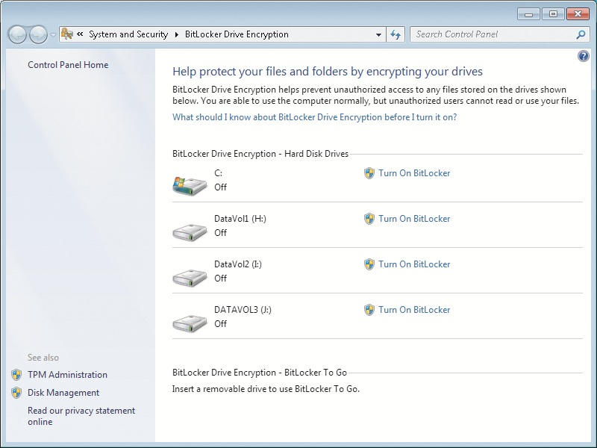
BitLocker Drive Encryption Window

Slide 58
BitLocker Drive Encryption (cont'd.)
BitLocker Drive Encryption modes
TPM only
Startup key
BitLocker Hard Drive Configuration
Hard drive must be divided into two partitions
Encrypted partition: the operating system volume
Unencrypted system partition: contains necessary files to boot the operating system

Slide 59
BitLocker Drive Encryption (cont'd.)
BitLocker Encryption Keys
Volume Master Key (VMK)
Encrypt data on the operating system volume
Full Volume Encryption Key (FVEK)
Used to encrypt the VMK
Recovering BitLocker-Encrypted Data
A recovery password is generated automatically
You can save it to a USB drive or folder, display on the screen, or print

Slide 60
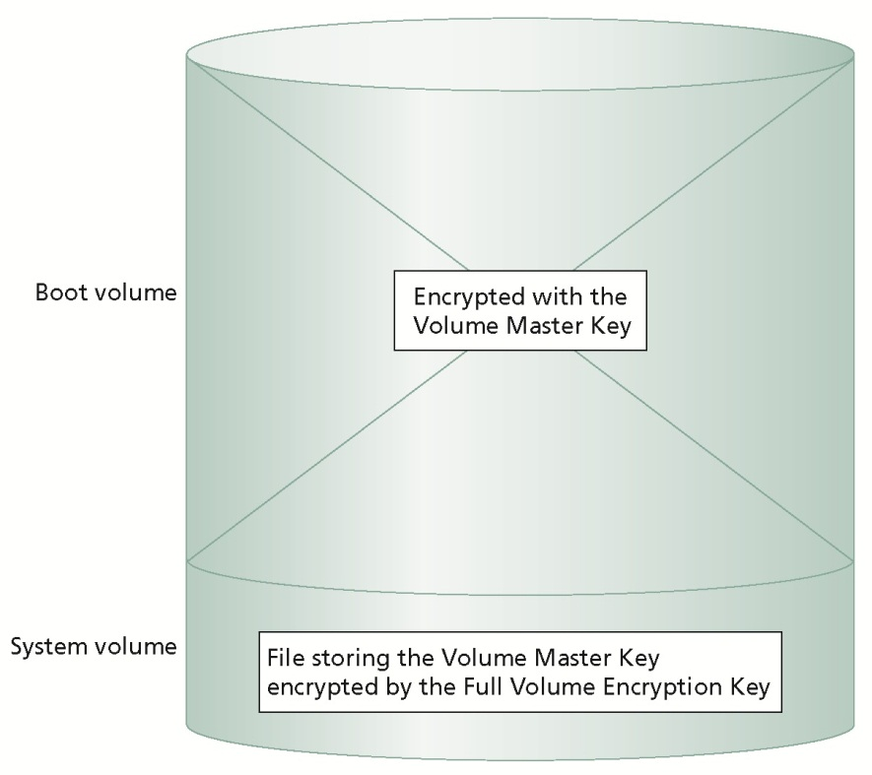
BitLocker Drive Encryption (cont'd.)

Slide 61
BitLocker Drive Encryption (cont'd.)
Recovering BitLocker-Encrypted Data (cont'd.)
Recovery password is required when the normal decryption process is unable to function
Most common reasons include:
Modified boot files
Lost encryption keys
Lost or forgotten startup PIN
Disabling BitLocker Drive Encryption
Decrypts all of the data on the hard drive and makes it readable again

Slide 62
BitLocker Drive Encryption (cont'd.)
BitLocker To Go
Included with Windows 7
Protects data on removable storage such as USB drives
Options for unlocking removable storage:
Use a password to unlock the drive
Use my smart card to unlock the drive

Slide 63
Windows Update
Scheduling automatic updates with Windows Update
The most important security precaution you can take with Windows 7
When a Windows security flaw is found, the flaw is reported to Microsoft
Microsoft releases a patch to fix the problem
Windows Update categories
Important
Recommended
Optional

Slide 64
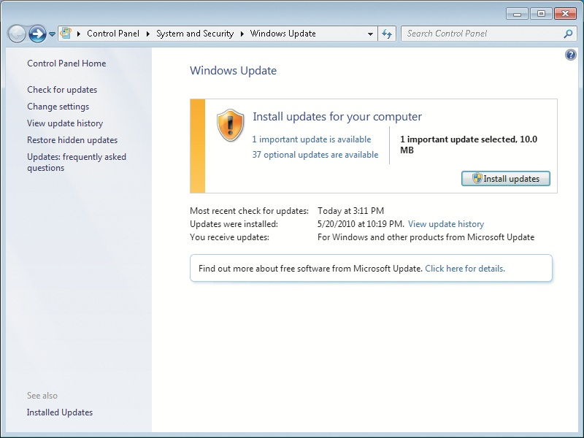
Windows Update Window

Slide 65
Windows Update (cont'd.)
Windows Update settings
Install updates automatically (recommended)
Download updates but let me choose whether to install them
Check for updates but let me choose whether to download and install them
Never check for updates (not recommended)
Microsoft Update is an alternative to Windows Update

Slide 66
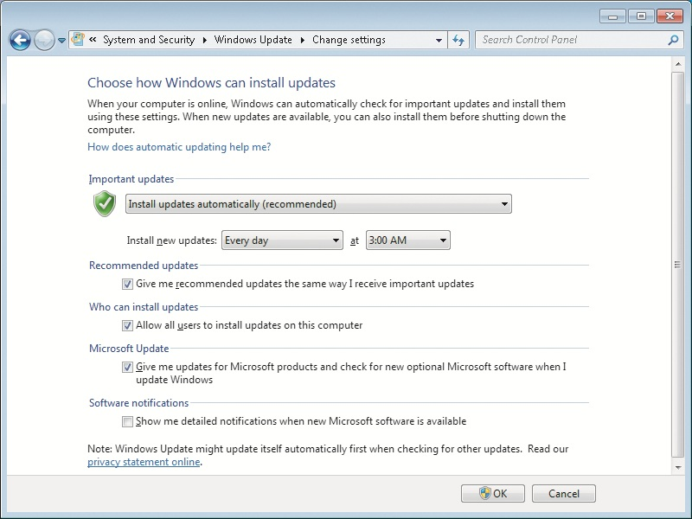
Windows Update Change Settings Window

Slide 67
Windows Update (cont'd.)
Windows Update process can be modified to use Windows Server Update Services (WSUS)
WSUS allows corporations to test patches before releasing them

Slide 68
Action Center
Action Center
Control Panel applet that lets you quickly check important security settings in Windows 7
Settings monitored by Windows Security
Network Firewall
Windows Update
Virus protection
Spyware and unwanted software protection
Internet security settings
User Account Control
Network Access Protection

Slide 69
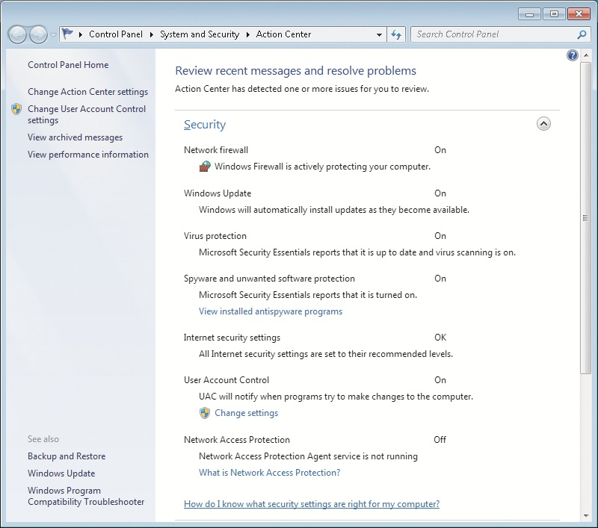
Windows Action Center Window

Slide 70
Summary
Windows 7 has new improved security features
Windows 7 supports various security policies including local security and account policies
Security templates can be used to configure or analyze Windows 7 security options
Analyzing and applying security templates is done with Secedit or the Security Configuration and Analysis MMC snap-in
Auditing is used to record specific operating system events to the security log

Slide 71
Summary (cont'd.)
UAC increases security by allowing users to log on and perform their jobs with standard user accounts
Windows Defender is antispyware software
Microsoft Security Essentials is free antivirus software
EFS protects individual files by encrypting them
BitLocker Drive Encryption encrypts an entire partition
Windows Update ensures that patches are applied to Windows 7 as they are made available

